Slide 1

Secure Messaging Application
Course Name: OOPS with C++
Course Code: E1UA203C
Group Members Name:
1. Satyam (24SCSE1040335)
2. KamleshPandey(24SCSE1040769)
3. Aryan Ojha (24SCSE1040778)

Slide 2

Introduction
This project is a simple console-based secure messaging system developed in C++. It allows users to log in and exchange encrypted messages. Messages are stored in a file using XOR encryption for basic security. Users can view only their own messages, which are decrypted when displayed.
This project highlights key C++ concepts like file handling, encryption, user authentication, and menu-driven programs. It is a basic yet effective example of secure communication using C++.

Slide 3
Feasibility of Project
1. Technical Feasibility
Developed in C++ using basic file handling and XOR encryption.
Runs on any system with a C++ compiler.
Simple login system with fixed users.
2. Economic Feasibility
Very low cost, no special tools required.
Uses open-source tools and standard C++ libraries.
Minimal maintenance needed.
3. Operational Feasibility
Easy to use console interface.
Basic send/receive message functionality.
Suitable for learning encryption and basic secure communication.

Slide 4
Project Implementation Plan
Design user and mapping app
Implement registration, login/logout functionality.
Code caser cipher - based encryption and decryption.
Implement messaging logic .
Test, debug and finalize.

Slide 5

Project Domain Introduction
Domain: Cybersecurity / Secure Communication
The project belongs to the domain of secure communication, which focuses on protecting information shared between users.
It aims to provide privacy and confidentiality during message exchange by using encryption techniques.
Secure messaging is important in today’s digital world to prevent unauthorized access, hacking, and data leaks.
This project demonstrates the basic concept of message encryption and decryption to keep conversations safe.
It is useful for learning how to implement simple cryptographic methods and secure file handling in C++.

Slide 6

Project Outcomes
1.Users can securely send and receive messages using simple encryption (XOR).
2.Messages are stored in encrypted form to prevent unauthorized reading.
3.Basic login system ensures only authorized users can access the app.
4.Demonstrates how encryption and decryption protect message privacy.
5.Provides a simple example of file handling and user authentication in C++.
6.Helps understand the fundamentals of secure communication in software.

Slide 7
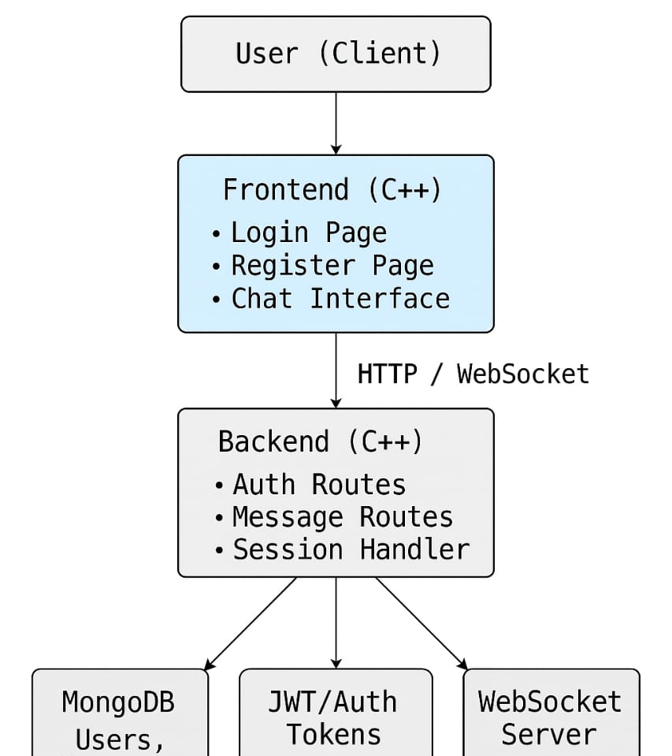
OBJECTIVES: 1.To build a simple messaging system with user login and logout
This C++ console-based messaging system allows users to register and log in using a username and password. User credentials are stored in a text file (users.txt). Once logged in, users can send messages, which are saved in another file (messages.txt). They can also view all previous messages stored in the system. The application uses classes and file handling for core functionality.

Slide 8
2.To apply encryption and decryption techniques using C++
Use
Use a symmetric encryption algorithm like Caesar Cipher (simple) or AES (advanced using external libraries) to encrypt messages before saving.
Encrypt
Encrypt user passwords during registration and store only the encrypted form.
Decrypt
Decrypt messages and passwords only when needed for display or authentication.
Use
Use file handling to save/load encrypted data securely.
Use
Optionally use C++ cryptographic libraries like Crypto++ or OpenSSL for real-world security.

Slide 9

3.To use OOP concepts like classes and objects in real applications.
Use classes to represent core entities like User, Message, and MessageSystem.
Create objects to manage user actions (login, register) and message functions (send, view).
Apply encapsulation to keep user data and message content private using private access specifier.
Use constructors to initialize user or message objects and methods to perform operations.
Organize the program using modularity, making the code reusable, secure, and easier to maintain.

Slide 10

4.To store and manage multiple users with secure authentication.
Store multiple users' credentials in a file (users.txt), using encryption (e.g., Caesar or SHA hashing).
Create a User class with methods for registration, login, and password encryption.
During login, read the file and validate credentials after decrypting or comparing hashed values.
Use vectors or maps (for in-memory apps) to manage users, or read from file for persistent storage.
Keep passwords encrypted in storage, and never store or display plain-text passwords.

Slide 11
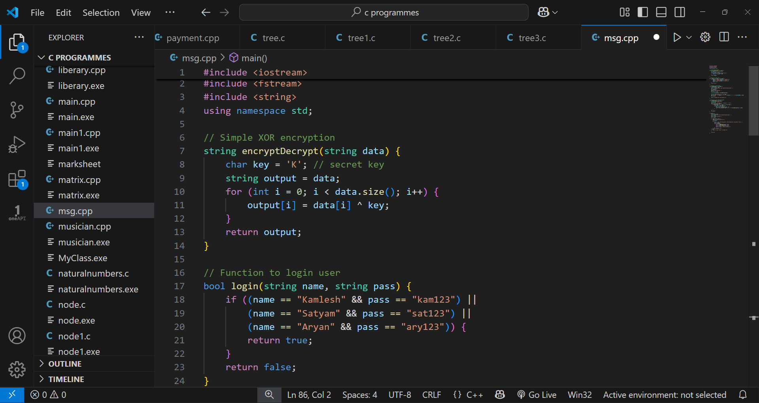
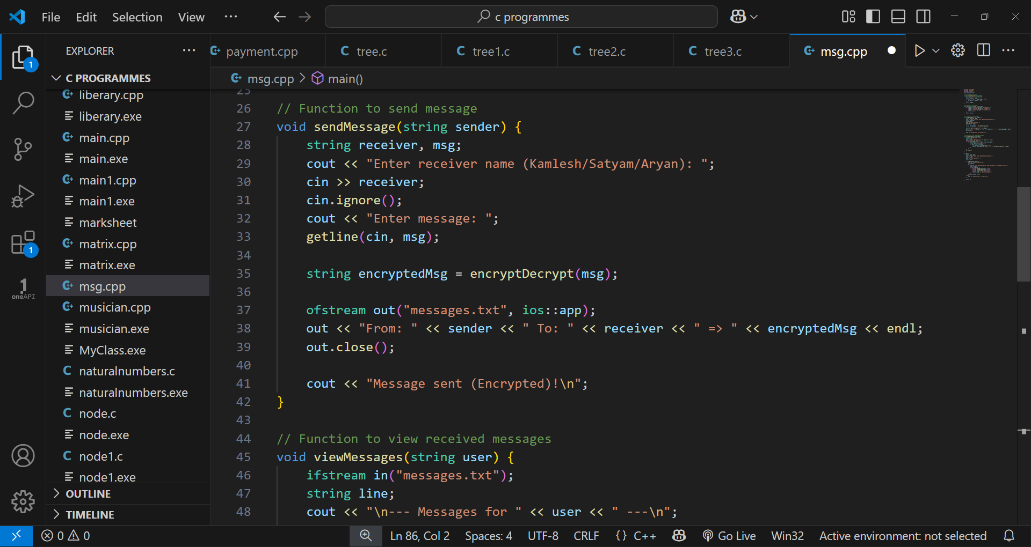
Screenshots and other diagrams
Code :
.

Slide 12
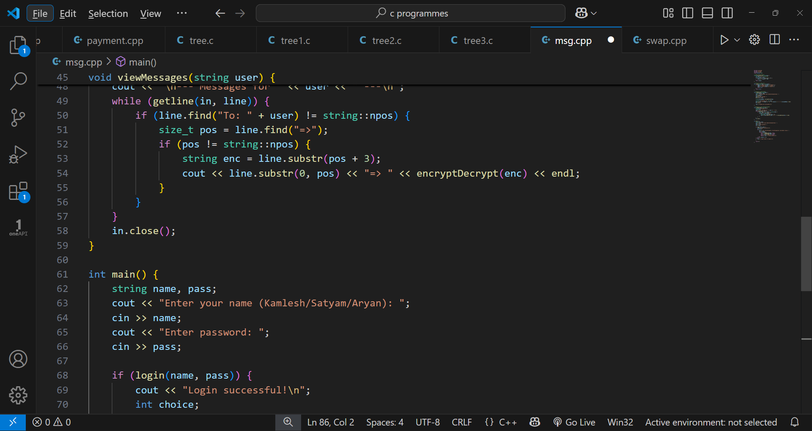
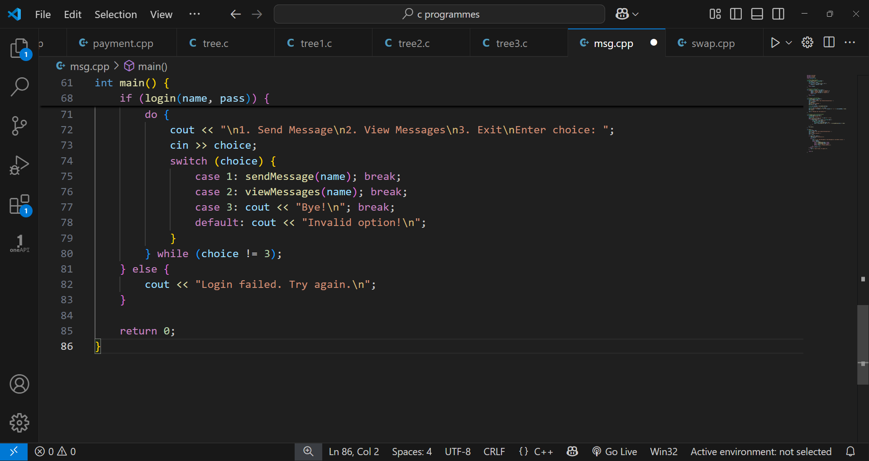
...

Slide 13
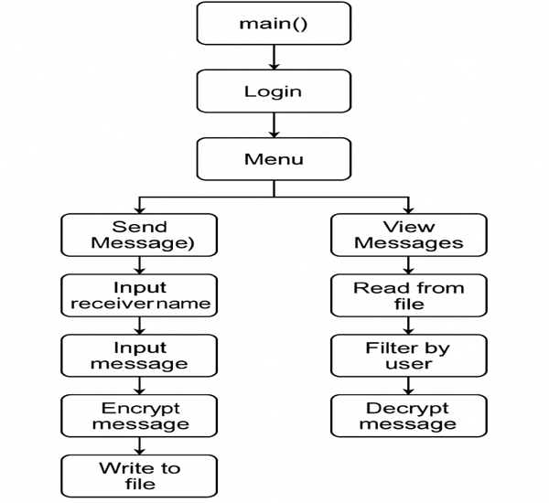
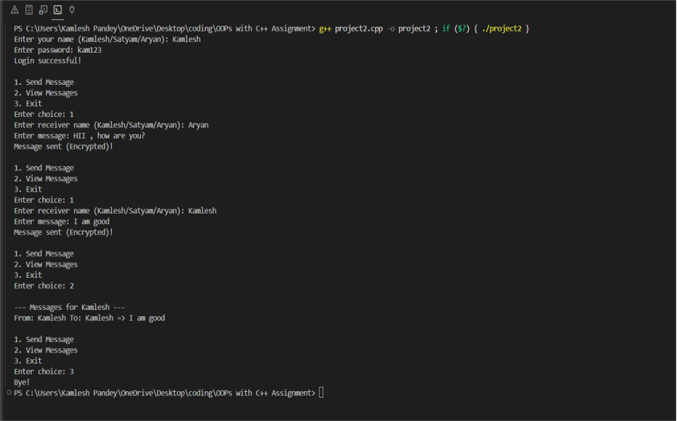
Output

Slide 14

Application Area of Work
Educational tool for learning encryption and OOP.
→ This project helps students understand how encryption and OOP work in real life.
→ It's a hands-on way to learn C++ concepts through a working app.
Simulated messaging apps.
→ The project acts like a basic version of messaging apps (e.g., WhatsApp).
→ It includes core features like login and sending encrypted messages.
Secure internal chat systems ( for small groups or demos).
→ Can be used for secure communication within a team or small group.
→ Useful for classroom demos or private group chats without the internet.

Slide 15

Thanks and Regards

